Slide 1
Lab 2
09/10/2025

Slide 2
Learning Objectives
Sample (auto)correlation function
Estimation, description
Deduce within-subject correlation models
Using sample (auto)correlation
Weighted Least Squares Regression
Fitting, statistical properties

Slide 3
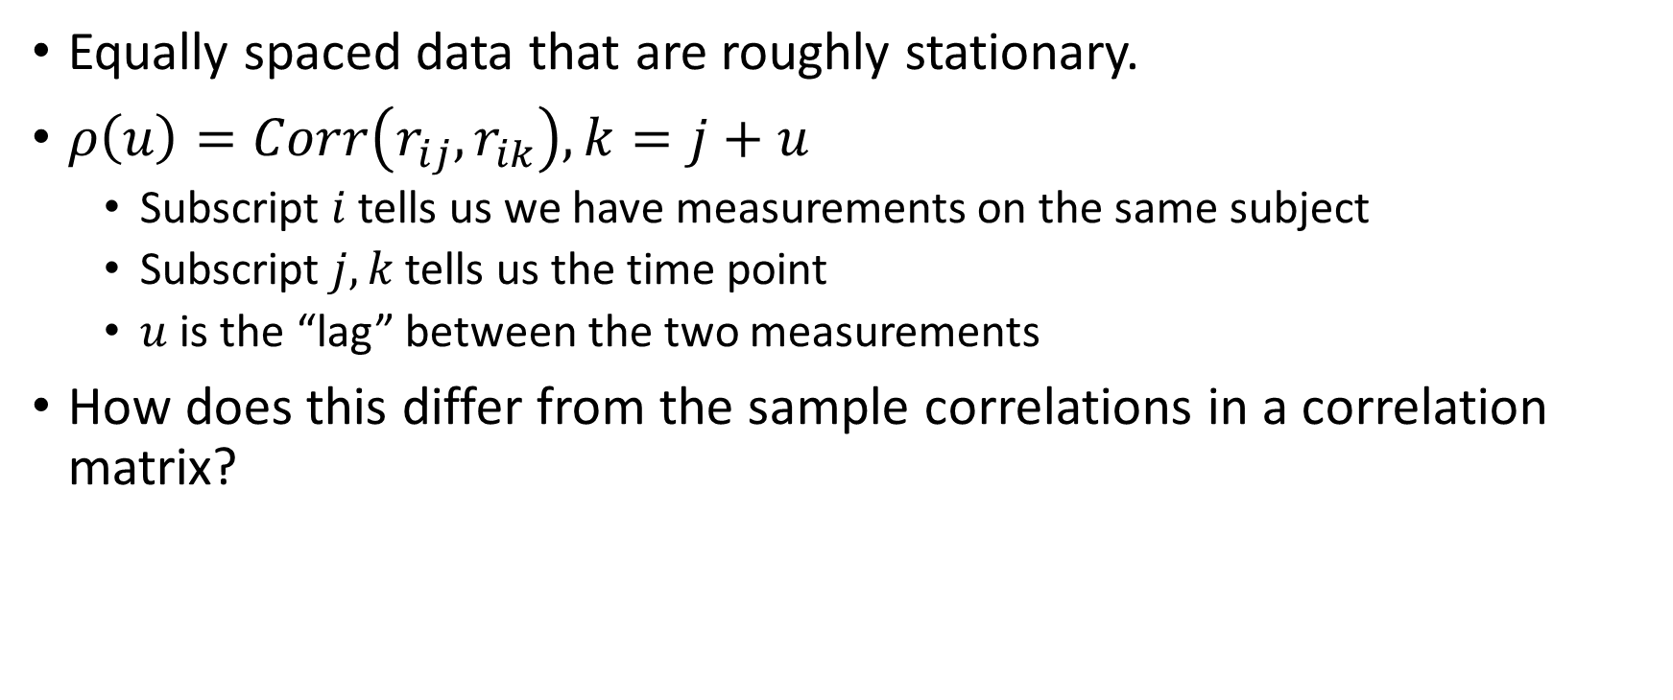
Autocorrelation function (ACF)
Equally spaced data that are roughly stationary.
$ρ\left(u\right)=Corr\left(r_{ij},r_{ik}\right), k=j+u$
Subscript $i$ tells us we have measurements on the same subject
Subscript $j,k$ tells us the time point
$u$ is the “lag” between the two measurements
How does this differ from the sample correlations in a correlation matrix?

Slide 4
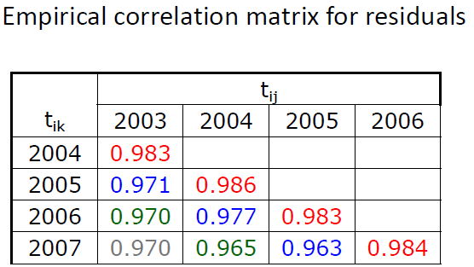
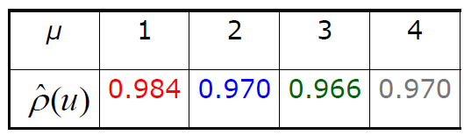
Autocorrelation function (ACF)
ACF

Slide 5
Types of correlation structures (Lect. 4)
Unstructured
Exchangeable
Autoregressive
Exponential
Toeplitz
Banded k [fill in the blank]

Slide 6
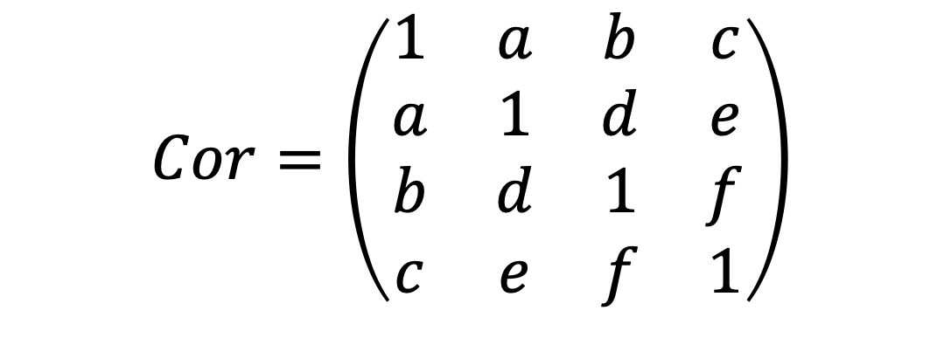
Unstructured Correlation
$$Cor=\left(\begin{matrix}1 & a & b & c \\ a & 1 & d & e \\ b & d & 1 & f \\ c & e & f & 1\end{matrix}\right)$$

Slide 7
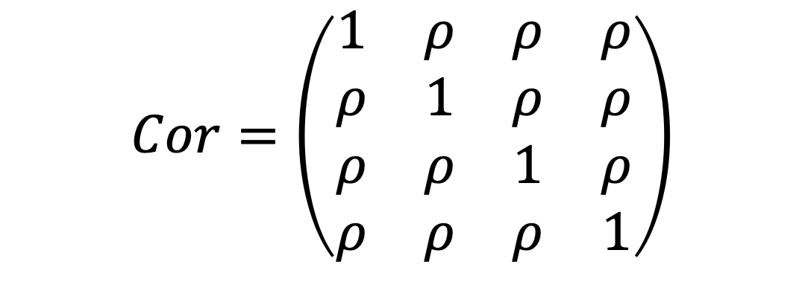
Exchangeable Correlation
$$Cor=\left(\begin{matrix}1 & ρ & ρ & ρ \\ ρ & 1 & ρ & ρ \\ ρ & ρ & 1 & ρ \\ ρ & ρ & ρ & 1\end{matrix}\right)$$

Slide 8
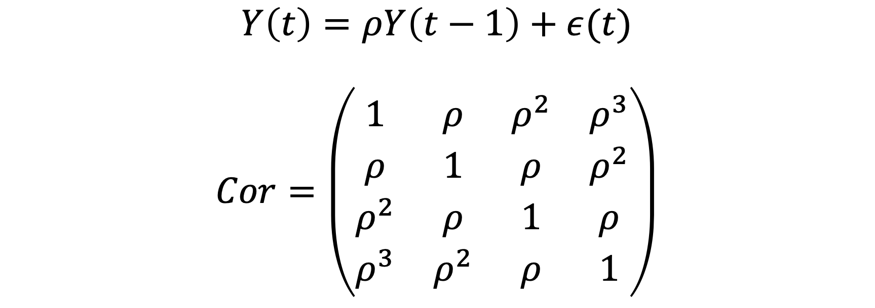
Autoregressive Correlation
$$Y\left(t\right)=ρY\left(t−1\right)+ε(t)$$
$$Cor=\left(\begin{matrix}1 & ρ & ρ^{2} & ρ^{3} \\ ρ & 1 & ρ & ρ^{2} \\ ρ^{2} & ρ & 1 & ρ \\ ρ^{3} & ρ^{2} & ρ & 1\end{matrix}\right)$$

Slide 9

Toeplitz Correlation
$$Cor=\left(\begin{matrix}1 & a & b & c \\ a & 1 & a & b \\ b & a & 1 & a \\ c & b & a & 1\end{matrix}\right)$$

Slide 10

Banded Correlation
$$Cor=\left(\begin{matrix}1 & a & b & 0 \\ a & 1 & a & b \\ b & a & 1 & a \\ 0 & b & a & 1\end{matrix}\right)$$

Slide 11
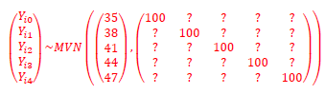
Question 1: Autocorrelation function
We’ll look at Toeplitz, exchangeable, and autoregressive correlation structures.
The correlation structure will affect our off-diagonals.

Slide 12
Question 1: Autocorrelation function
STATA:
regress y i.time
predict resid, resid
autocor resid time id
R:
fit <- gls(y ~ as.factor(time), data)
ACF(fit, form= ~ 1|id)
Lag | Hypothetical Study 1 Sample ACF | Hypothetical Study 2 Sample ACF | Hypothetical Study 3 Sample ACF
1
2
3
4
Parametric model:

Slide 13
Question 1: Autocorrelation function
STATA:
regress y i.time
predict resid, resid
autocor resid time id
R:
fit <- gls(y ~ as.factor(time), data)
ACF(fit, form= ~ 1|id)
Lag | Hypothetical Study 1 Sample ACF | Hypothetical Study 2 Sample ACF | Hypothetical Study 3 Sample ACF
1 | 0.856 | 0.825 | 0.779
2 | 0.820 | 0.836 | 0.586
3 | 0.741 | 0.789 | 0.383
4 | 0.731 | 0.820 | 0.269
Parametric model:

Slide 14
Question 2: Estimate monthly improvement in SF-36 scores (OLS)
Stata
regress y time
mixed y time || id: , nocons residuals(un, t(time))
R
fit.ols <- lm(y ~ time, data)
fit.wls <- gls(y ~ time,
correlation = corSymm(form = ~ 1 | id),
weights=varIdent(form= ~ 1 | as.factor(time),
data=data, method="ML")

Slide 15
Question 2: Estimate monthly improvement in SF-36 scores (OLS & WLS)
 | Monthly Improvement in SF-36
Data | Coefficient |  | SE
 | OLS | WLS | OLS | WLS
Autocor1 | 2.83 | 2.88 | 0.329 | 0.175
Autocor2 | 2.93 | 2.93 | 0.297 | 0.123
Autocor3 | 2.82 | 2.83 | 0.284 | 0.273

Slide 16
Question 2: Estimate monthly improvement in SF-36 scores (OLS & WLS)
Do the estimated monthly improvement in SF-36 mental health scores differ across the two statistical methods? If so, why?

Slide 17
Question 2: Estimate monthly improvement in SF-36 scores (OLS & WLS)
Do the standard errors for the estimated monthly improvements differ across the two statistical methods? If so, why?

Slide 18
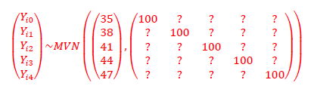
Question 2: Estimate monthly improvement in SF-36 scores (OLS & WLS)
What is the true monthly improvement in SF-36 mental health scores?

Slide 19
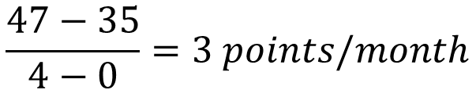
Question 2: Estimate monthly improvement in SF-36 scores (OLS & WLS)
What is the true monthly improvement in SF-36 mental health scores?
$$\frac{47−35}{4−0}=3 points/month$$

Slide 20
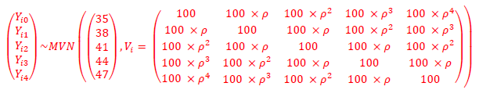
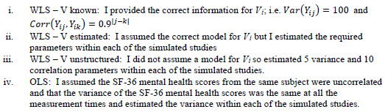
Question 3: Simulation study

Slide 21
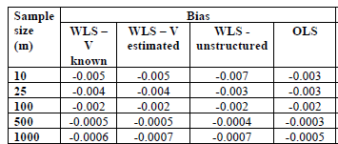
Question 3: Simulation Study – Bias
Bias and variance of the 10,000 estimated monthly improvements in SF-36 mental health scores based on different sample sizes and the models i. through iv.
We can calculate bias because we know the true improvement is 3 points / month.

Slide 22

Question 3: Simulation Study – Bias
Should we see bias when we use the wrong within-subject variance structure?
$$E\left[{\hat{β}}_{wls}\right]=E\left[{\left(X^{T}WX\right)}^{−1}X^{T}WY\right] \\ ={\left(X^{T}WX\right)}^{−1}X^{T}WE\left[Y\right] \\ ={\left(X^{T}WX\right)}^{−1}X^{T}WXβ \\ =β$$

Slide 23
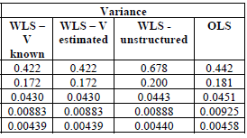
Question 3: Simulation Study – Variance

Slide 24
Question 3: Simulation Study – Variance
Why do we have such good agreement between WLS – V known and WLS – V estimated?

Slide 25
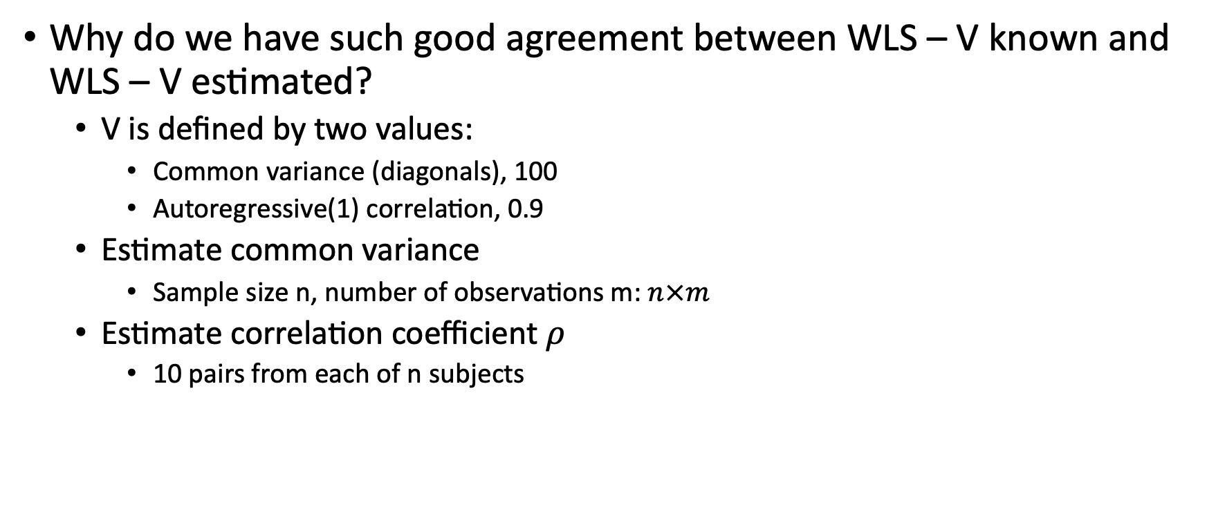
Question 3: Simulation Study – Variance
Why do we have such good agreement between WLS – V known and WLS – V estimated?
V is defined by two values:
Common variance (diagonals), 100
Autoregressive(1) correlation, 0.9
Estimate common variance
Sample size n, number of observations m: $n×m$
Estimate correlation coefficient $ρ$
10 pairs from each of n subjects

Slide 26
Question 3: Simulation Study – Variance
Why is there some disagreement between WLS – V known and WLS – V unstructured?
Why might these differences become smaller with increasing sample size?

Slide 27
Question 3: Simulation Study – Variance
Why is there some disagreement between WLS – V known and WLS – V unstructured?
We need to estimate many more parameters than before!
5 time-specific variances (diagonals)
N observations at each time (1 from each subject)
10 pairwise correlations
N pairs of values for each pairwise correlation (1 pair from each subject)
Why might these differences become smaller with increasing sample size?
More data to estimate the parameters.

Slide 28

Question 3: Simulation Study – Efficiency
$$\frac{Var\left(OLS\right)}{Var\left(V−estimated\right)}=relative efficiency$$

Slide 29
Key takeaways:
WLS procedure produces unbiased estimate even if we use wrong V.
Specifying wrong model for V impacts inference!
Why wouldn’t we always use unstructured?
Many more parameters to estimate!
Could have poor estimates if you have small data.
Why not use OLS?
Inefficient if you’re interested in inference.
Inefficiency depends on strength of correlation.

